Slide 1


CMR TECHNICAL CAMPUS
UGC AUTONOMOUS
Accredited by NBA & NAAC with A Grade
Approved by AICTE, New Delhi and Affiliated to JNTU, Hyderabad
Department of Information Technology
Major Project Stage -2
Review-2
Project Title : Privacy Enhanced Anonymous Cloud Authentication Framework
With Multi-Factor Protection
Presented By :
Batch-14
H.No : 227R1A12B8 Name : P.Pravallika
H.No : 227R1A12C2 Name : R.Narendar
H.No : 227R1A1275 Name : Ch.Sai Kiran
Project Supervisor :
Name : V. Sri Suma
Designation : Assistant Professor

Slide 2
AGENDA
Introduction and overview of the project
Existing System
Disadvantages of Existing System
Proposed System
Advantages of Proposed System
Hardware and Software Requirements
Novelty of the Project
System Architecture
Modules
UML Diagrams
Source Code
Results
Conclusion & Future Enhancements
References
GitHub Link

Slide 3
INTRODUCTION AND OVERVIEW OF THE PROJECT
Cloud computing offers scalable and cost-effective data management but introduces privacy and security risks due to centralized control.
Existing encryption solutions lack proper user anonymity and are vulnerable to impersonation attacks.
The proposed framework ensures identity anonymization using hashed usernames and biometric data, along with session-based multi-factor authentication for secure access.
Hybrid encryption improves data protection, where ECC provides strong key security and ChaCha20 enables faster file encryption with over 50% performance improvement.

Slide 4
EXISTING SYSTEM
The Existing System represents a significant technological leap from the manual processes of the past, where data was physically stored in cabinets and security relied on locks and keys.
Today's cloud platforms use a centralized architecture that, while highly efficient and scalable, introduces new vulnerabilities. In this system, all user data, including usernames and passwords, is consolidated in a single central database.
Cloud administrators can track and profile user activities, compromising user anonymity.
Reliance on username-password authentication makes the system vulnerable to phishing, credential attacks, and unauthorized access while also failing to ensure user anonymity.

Slide 5
DISADVANTAGES OF EXISTING SYSTEM
Lack of User Anonymity: Centralized storage of user PII(Personally Identifiable Information ) allows administrators to track and link user activities, posing serious privacy risks.
Vulnerability to Impersonation Attacks: Reliance on single-factor authentication makes the system prone to credential theft and unauthorized access.
Single Point of Failure: A centralized database creates a single vulnerability, where one breach can expose all user credentials and data.

Slide 6
PROPOSED SYSTEM
The proposed Privacy-Enhanced Anonymous Cloud Authentication Framework with Multi-Factor Protection is designed to overcome the limitations of existing systems by implementing a multi-layered security approach.
The framework shifts from a centralized model to a privacy-preserving, decentralized system, ensuring user anonymity.
Usernames and biometric data are hashed with SHA-256 during registration, preventing tracking or identity linkage.
Multi-factor authentication (password + biometric) secures login, with sessions terminated on logout to prevent misuse.

Slide 7
ADVANTAGES OF PROPOSED SYSTEM
User identities are protected by hashing usernames and biometric data, preventing tracking or profiling by the cloud server.
Multi-factor authentication using a password and biometric scan ensures strong protection against impersonation and unauthorized access.
Hybrid encryption combining ECC and ChaCha20 improves security while reducing computation time, enabling faster file uploads and downloads.

Slide 8
HARDWARE & SOFTWARE REQUIREMENTS
SOFTWARE REQUIREMENTS:
Python : 3.7.4
Operating system: Windows
Framework : Django
Database: MySQL
HARDWARE REQUIREMENTS:
Processor: Intel i5
Memory: 1 TB (storage)
RAM: 8 GB

Slide 9
NOVELTY OF THE PROJECT
Ensures user anonymity by hashing usernames and biometric data.
Implements biometric-based multi-factor authentication without storing raw biometrics.
Uses hybrid encryption (ECC + ChaCha20) for security with high performance.
Provides real-time encryption performance comparison using computation graphs.
Prevents cloud and session impersonation attacks through secure session control.
Enables privacy-preserving public/private file access in cloud storage.
Protects data even from cloud administrators (administrator-blind model).

Slide 10
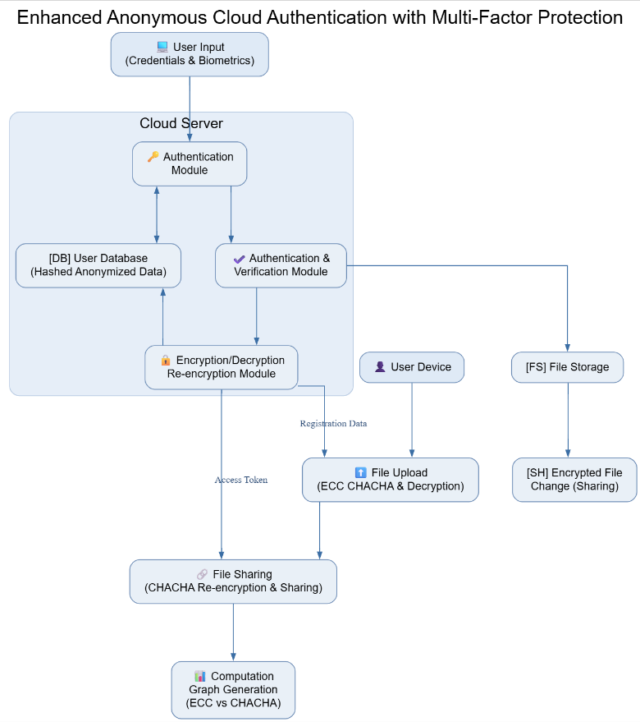
SYSTEM ARCHITECTURE

Slide 11
MODULES
1.User Input Module
User enters credentials (username, password) and biometric data.
Input data is hashed and anonymized before transmission to the cloud server.
The anonymized data is then sent securely to the Authentication Module.
2. Authentication Module
Receives hashed credentials from the User Input module.
Cross-verifies the user data with records in the User Database.
If authentication is valid, generates a verification token.
Passes control to the Authentication & Verification Module for secondary validation.

Slide 12
MODULES
3.Authentication & Verification Module
Performs multi-factor authentication using the verification token.
Confirms user identity by validating biometric data and hashed credentials.
Once verified, grants temporary access rights to the Encryption/Decryption Module.
4. Encryption/Decryption & Re-encryption Module
Encrypts user data using Elliptic Curve Cryptography (ECC) and ChaCha20 algorithms.
Generates a re-encryption key for secure data transmission and sharing.
Sends encrypted output to both File Upload and File Sharing modules.
Stores encrypted hashes in the User Database for future sessions.

Slide 13
MODULES
5. File Upload Module
Receives encrypted files + decryption info.
Uploads them to File Storage (FS).
Sends registration metadata back to cloud.
6.File Storage (FS) & Encrypted File Sharing (SH)
Stores uploaded encrypted files securely.
When file is shared/modified, uses Re-encryption Module to refresh keys.
Shared/changed data passed to SH (Encrypted File Change).

Slide 14
MODULES
7. File Sharing Module
Performs ChaCha-based re-encryption before sharing files.
Validates access tokens from authenticated users.
Allows secure access or transfer of encrypted files between users.
Sends sharing logs and encryption details forward.
8.Computation Graph Generation Module
Collects data from ECC and ChaCha operations.
Generates comparative graphs (e.g., encryption speed, resource usage).
Provides insight into performance between ECC and ChaCha mechanisms.

Slide 15
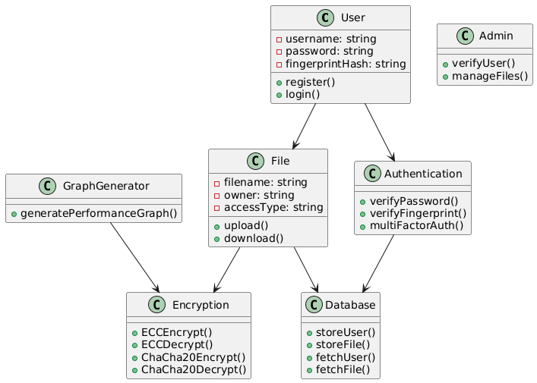
UML DIAGRAMS
Class Diagram

Slide 16
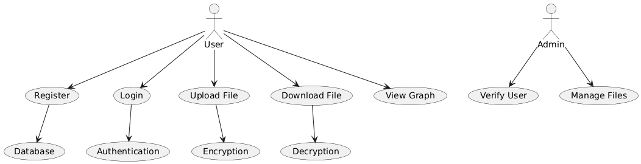
UML DIAGRAMS
Use Case Diagram

Slide 17
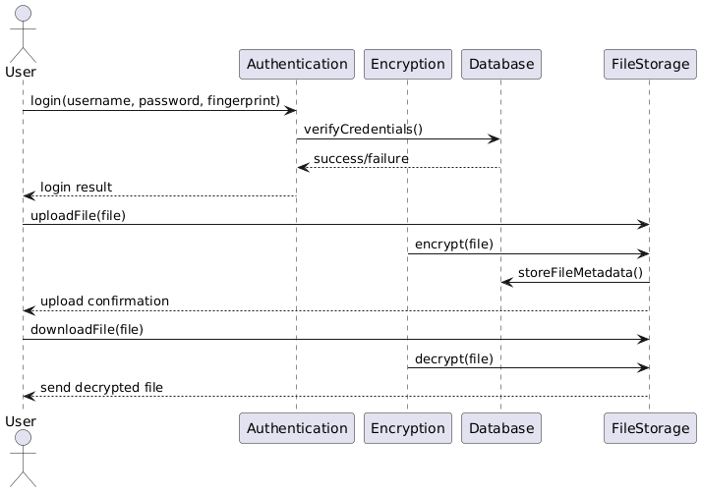
UML DIAGRAMS
Sequence Diagram

Slide 18
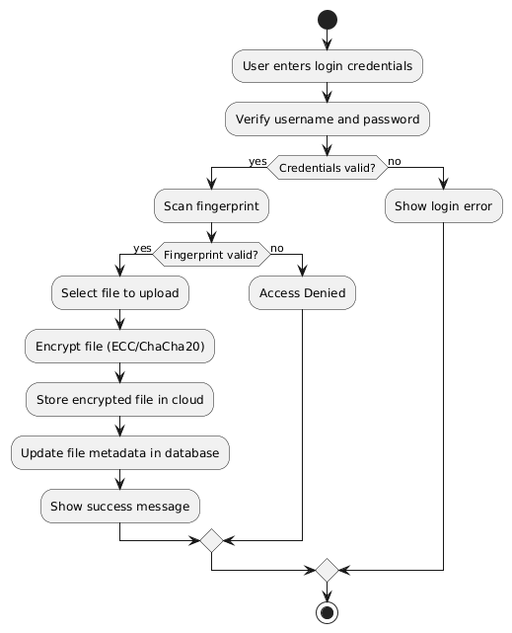
UML DIAGRAMS
Activity Diagram

Slide 19
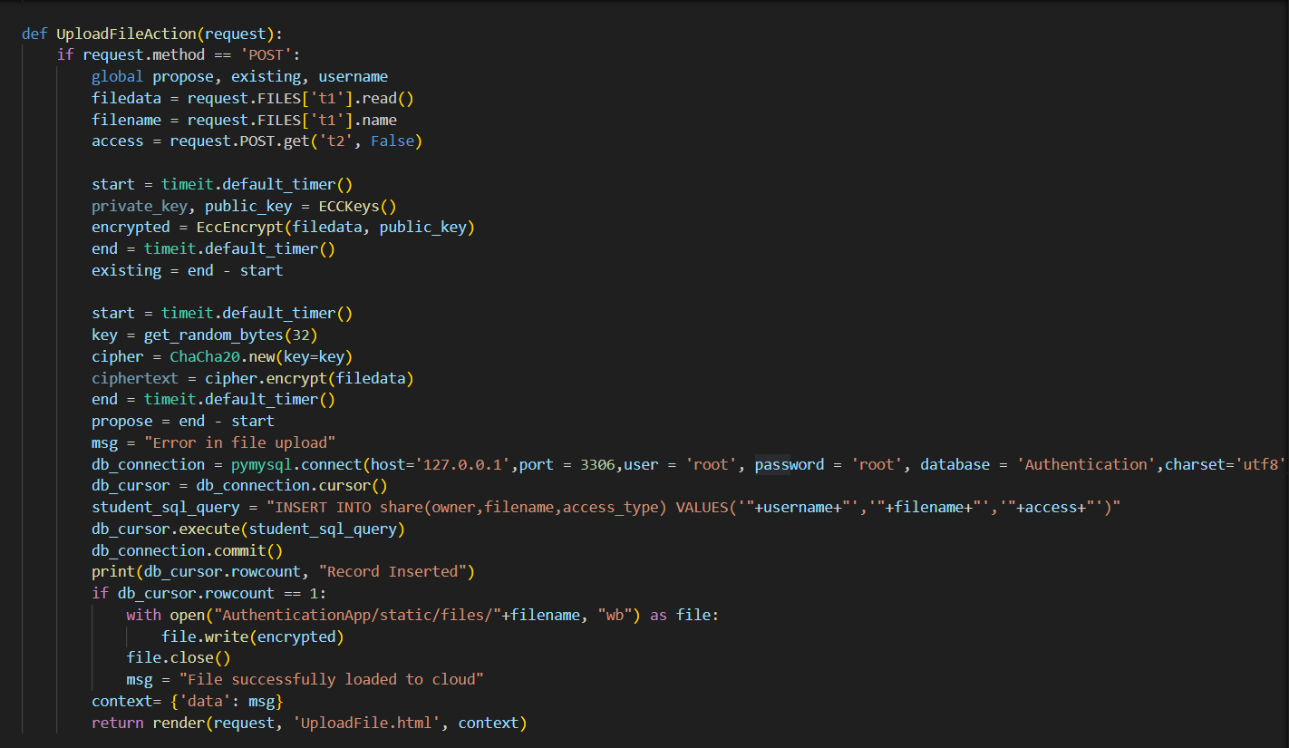
SOURCE CODE

Slide 20
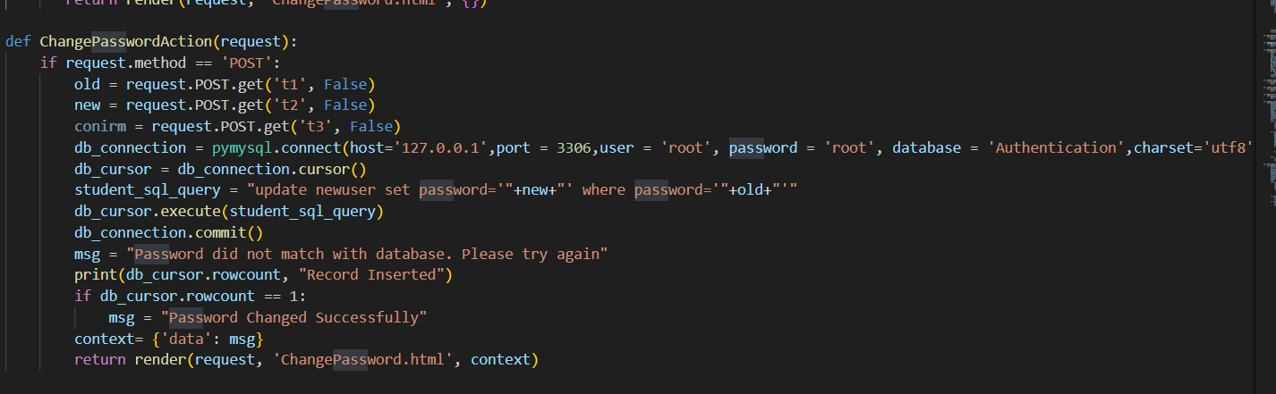
SOURCE CODE

Slide 21
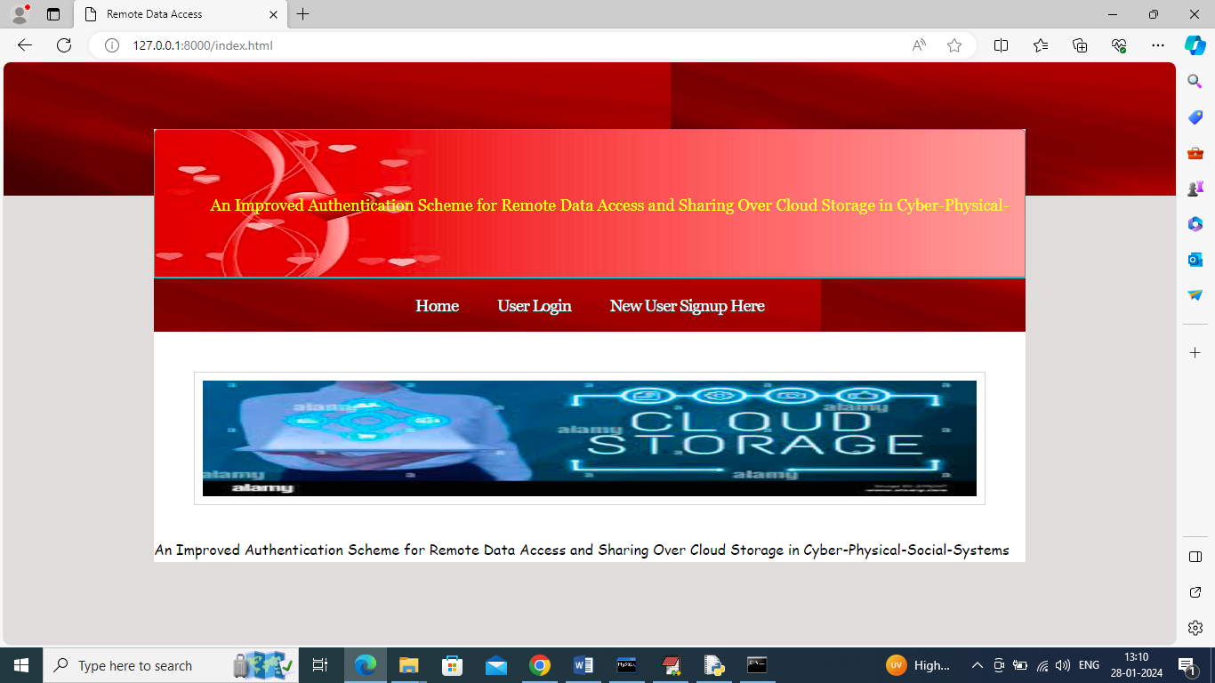
RESULTS
Home Page Screen

Slide 22
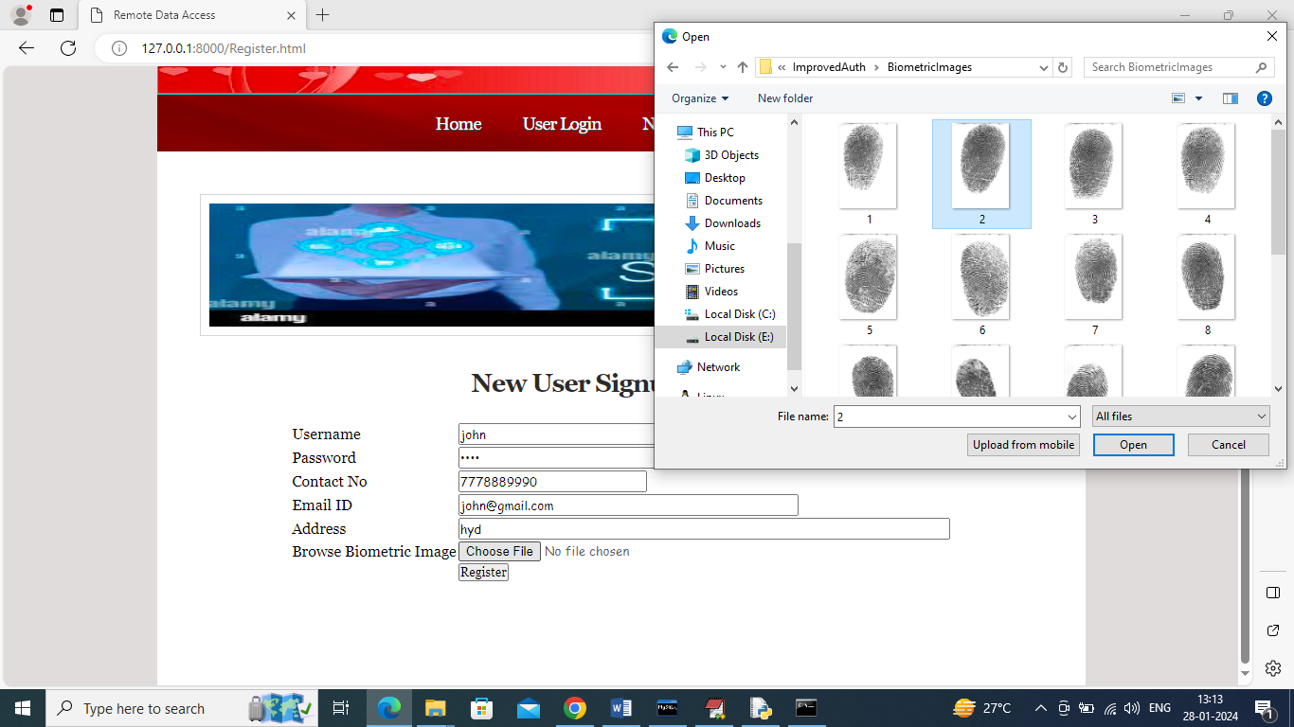
RESULTS
New User Signup Screen

Slide 23
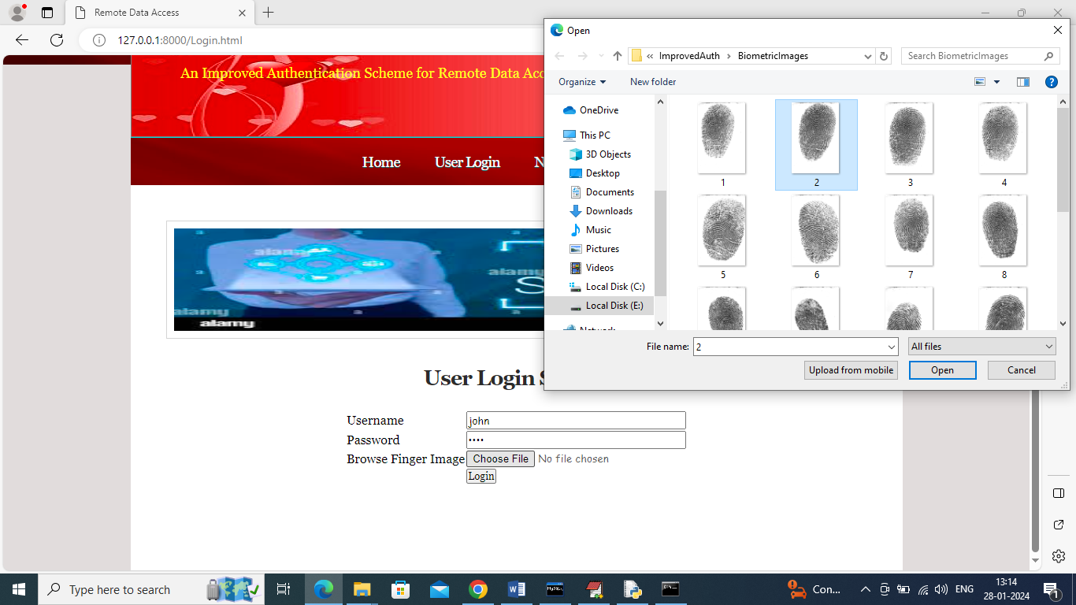
RESULTS
User Login Screen

Slide 24
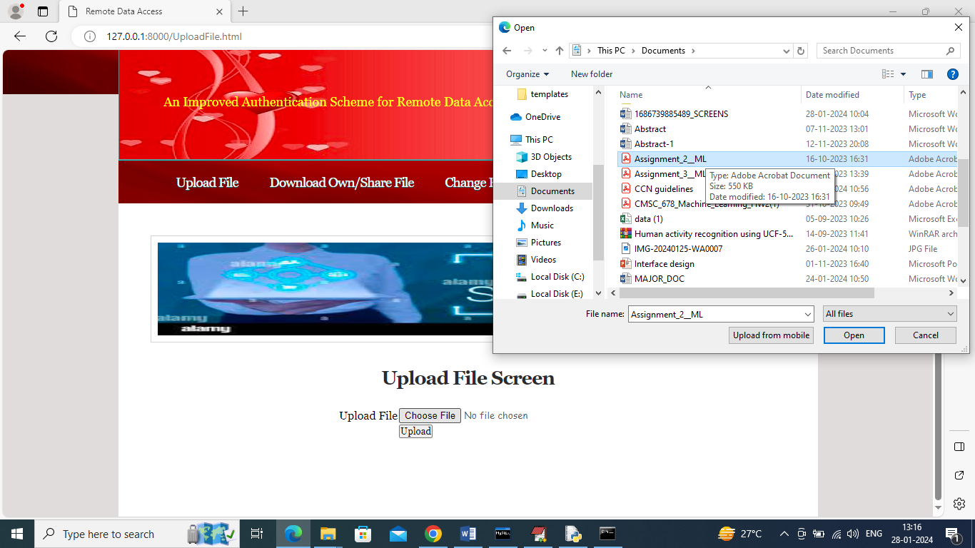
RESULTS
File Upload Screen

Slide 25
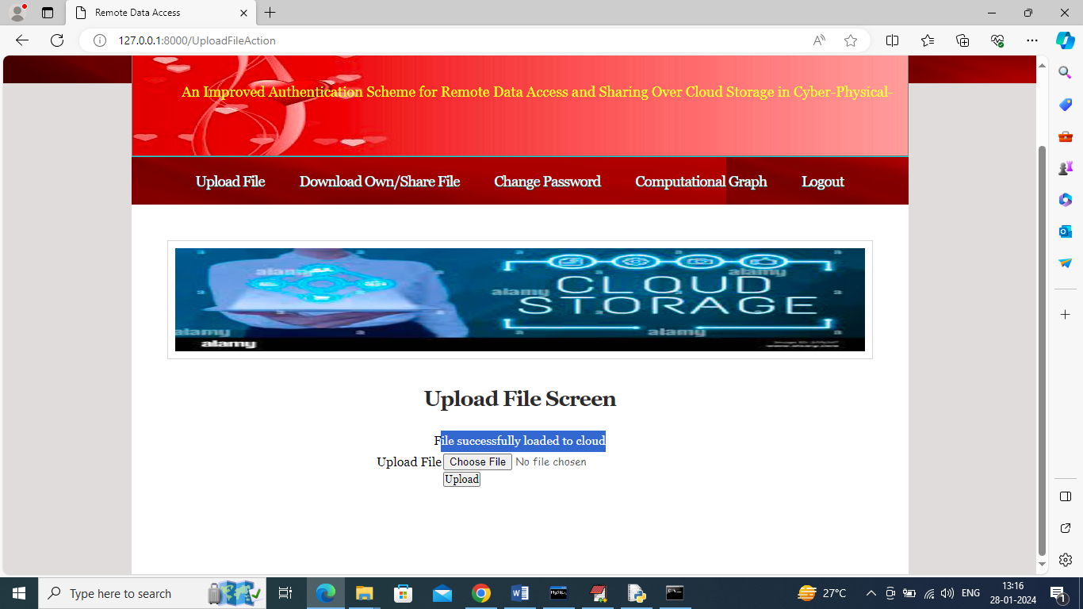
RESULTS
File Uploaded Screen

Slide 26
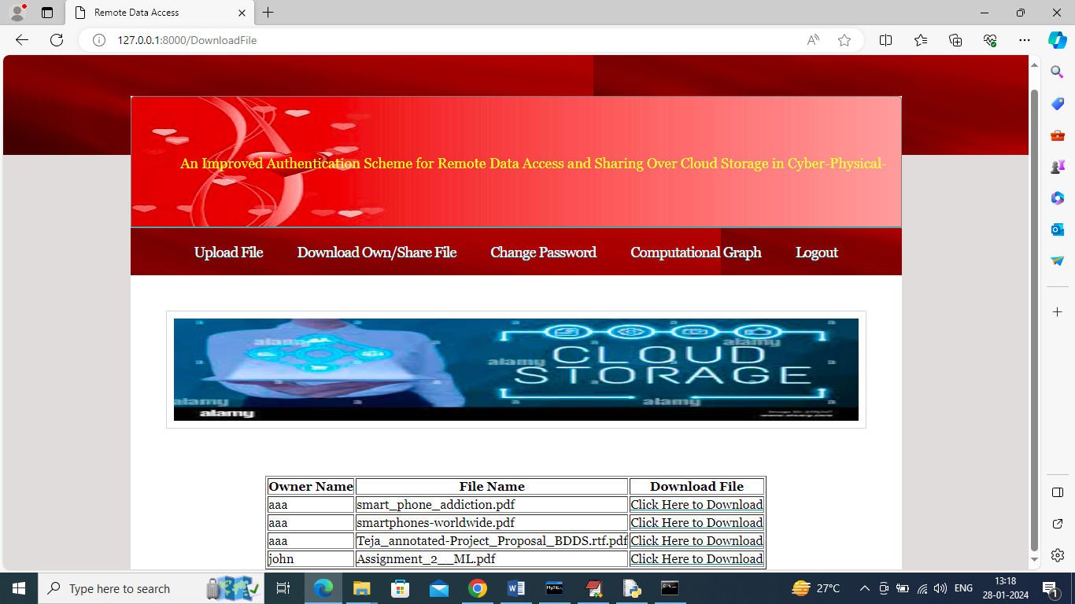
RESULTS
Download File Screen

Slide 27
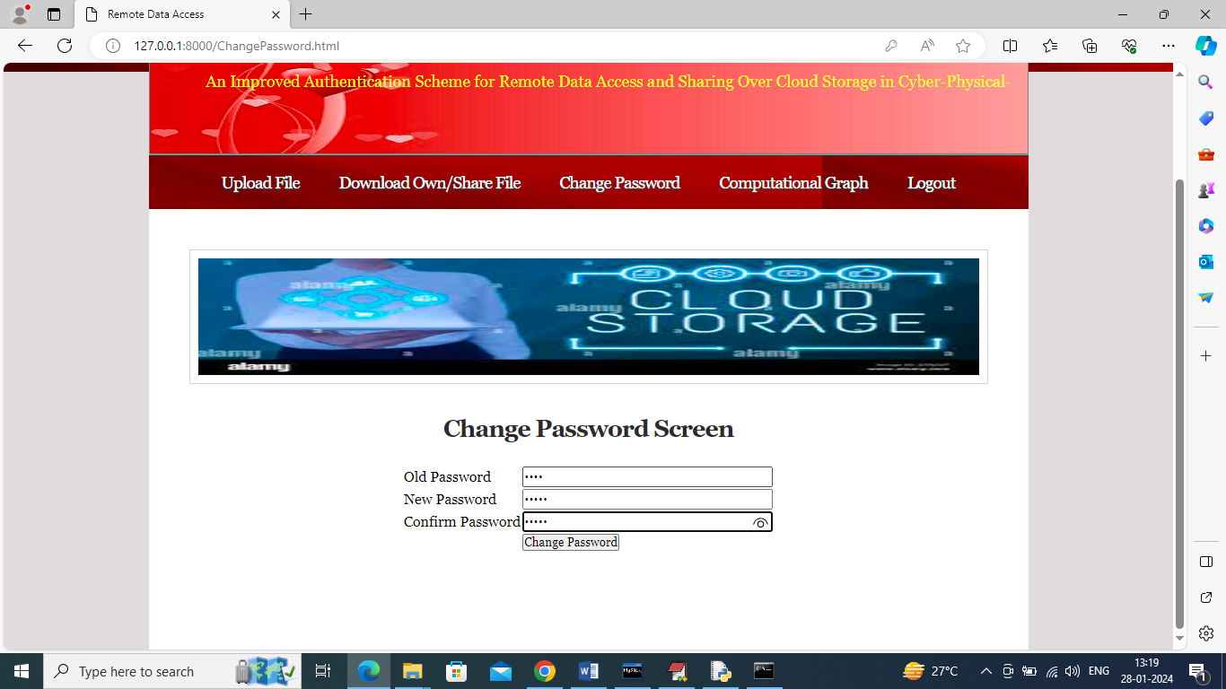
RESULTS
Password Change Screen

Slide 28
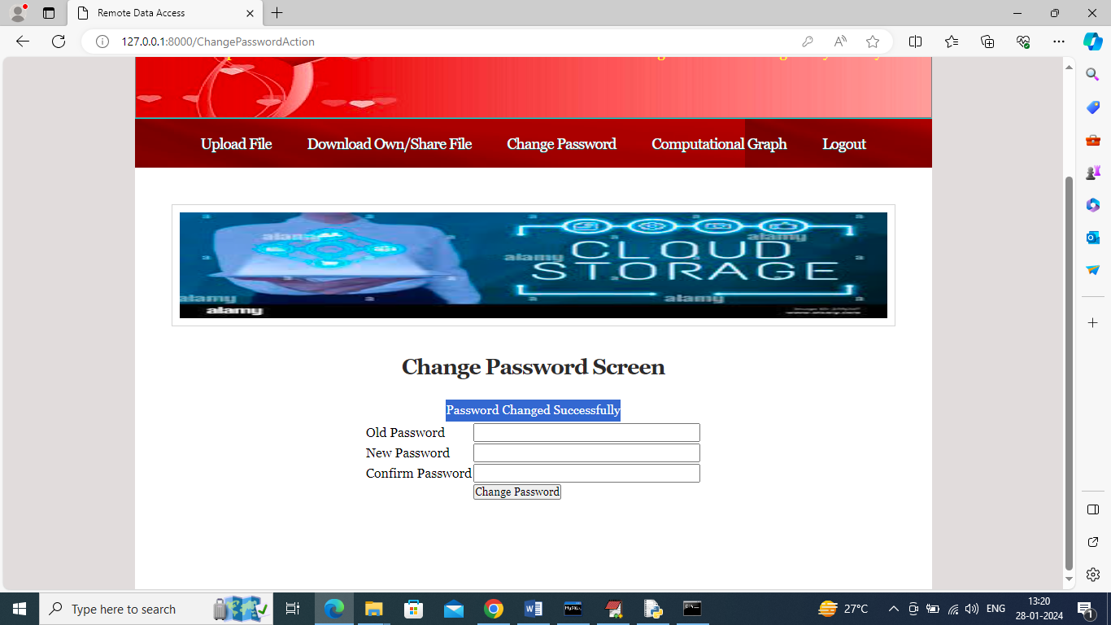
RESULTS
After Password Changing

Slide 29
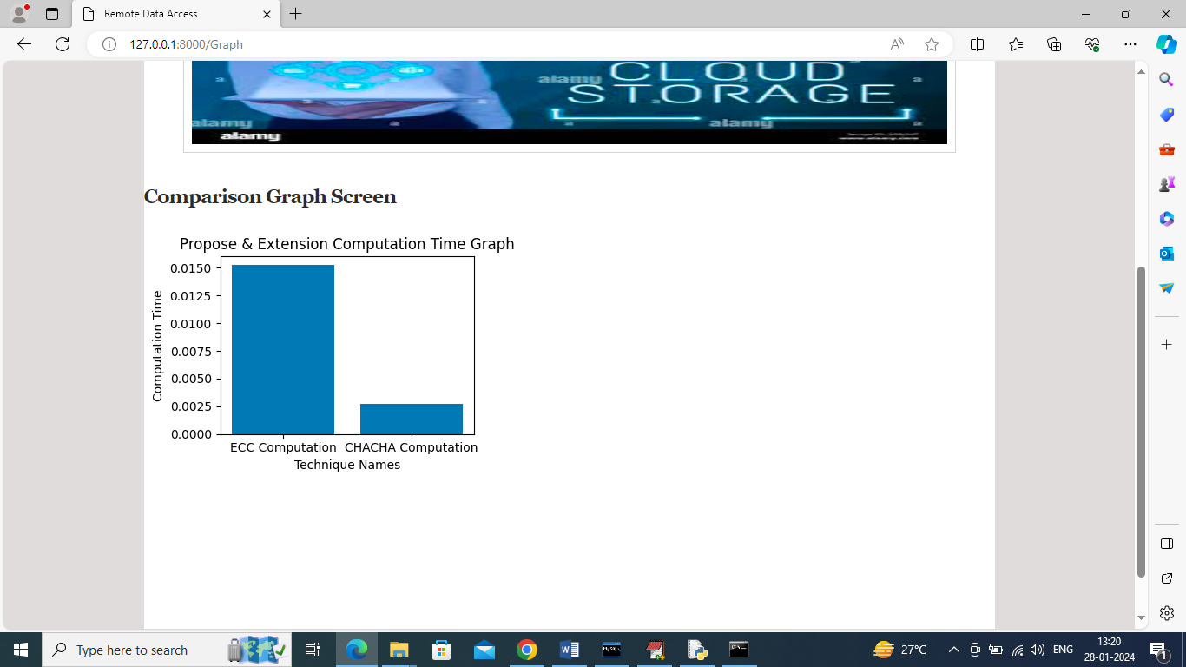
RESULTS
Model Comparison Screen

Slide 30
CONCLUSION & FUTURE ENHANCEMENT
Conclusion
Secure cloud framework using biometric multi-factor authentication and access control
Hybrid encryption (ECC + ChaCha20) achieves strong security with better performance
SHA-256 based anonymity ensures privacy and prevents unauthorized access
Future Enhancement
Integration Blockchain for tamper-proof authentication.
Enabling AI-based intrusion detection.

Slide 31
REFERENCES
Mostafa, A.M.; Ezz, M.; Elbashir, M.K.; Alruily, M.; Hamouda, E.; Alsarhani, M.; Said, W. Strengthening Cloud Security: An Innovative Multi-Factor Multi-Layer Authentication Framework for Cloud User Authentication. Appl. Sci. 2023, 13, 10871. https://doi.org/10.3390/app131910871
Alatawi, M.N. Blockchain-Driven Smart Contracts for Advanced Authorization and Authentication in Cloud Security. Electronics 2025, 14, 3104. https://doi.org/10.3390/electronics14153104
Tanveer, M.; Badshah, A.; Khan, A.; Alasmary, H.; Chaudhry, S. CMAF-IIoT: Chaotic map-based authentication framework for industrial internet of things. Internet Things 2023, 23, 100902.

Slide 32
GITHUB LINK
https://github.com/Pravallikapalvai/privacy-enhanced-anonymous-cloud-authentication-framework-with-multi-factor-protection

Slide 33
THANK YOU

